Slide 1

Title: ScamShield - A Phishing Email Detection System
Subtitle: Protecting Users from Scams and Malicious Content Presented by: Sandeep Vyas
Course: BCA 2023

Slide 2
Introduction
Problem Statement:
Increasing cyber threats like phishing emails, fraudulent messages, and malicious URLs.
Users often fall victim due to lack of awareness or detection tools.
Solution:
ScamShield: A web-based tool to detect scams in text/PDF content and classify URLs for threats.

Slide 3
Features
Text/PDF Scam Detection:
Analyzes uploaded files (PDF/TXT) to identify fraudulent content.
Uses AI to classify messages as "Real" or "Scam."
URL Threat Classification:
Classifies URLs into categories:
Benign
Phishing
Malware
Defacement

Slide 4
Technology Stack
Backend:
Python with Flask (web framework)
Google Gemini AI (for content and URL analysis)
PyPDF2 (for PDF text extraction)
Frontend:
HTML, CSS, JavaScript
Responsive and interactive UI with animations

Slide 5
How It Works (Text/PDF Detection)
User uploads a PDF or TXT file.
System extracts text and sends it to Gemini AI.
AI analyzes the content and returns a classification:
Real: Authentic message.
Scam: Fraudulent content with reasons.

Slide 6

How It Works (URL Detection)
User enters a URL.
System checks for valid format (HTTP/HTTPS).
Gemini AI classifies the URL into one of four categories:
Benign: Safe (e.g., google.com).
Phishing: Fraudulent (e.g., fake login pages).
Malware: Distributes harmful software.
Defacement: Hacked websites.

Slide 7
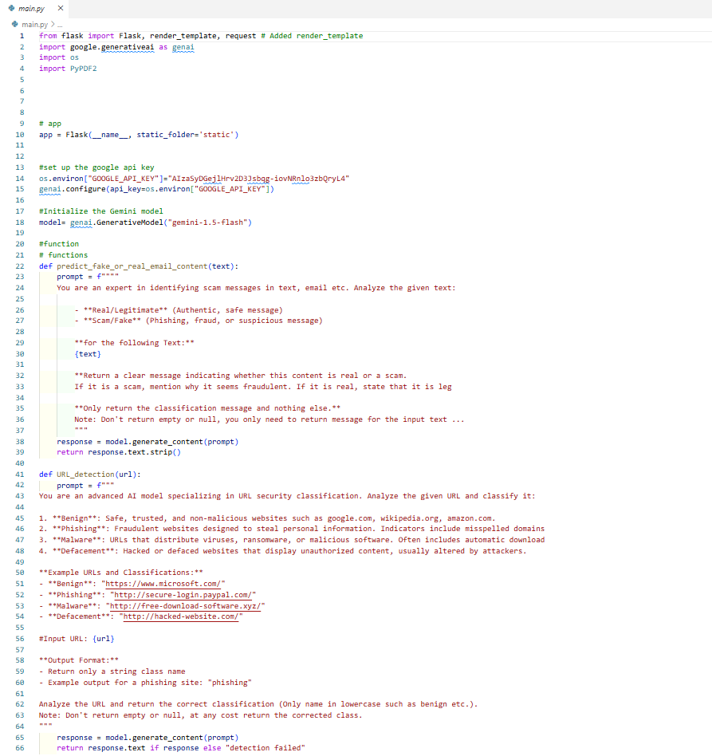
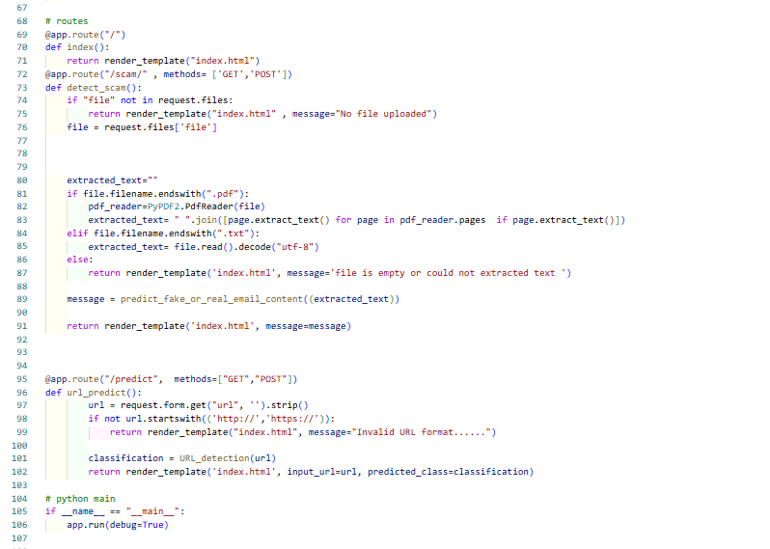
Code

Slide 8
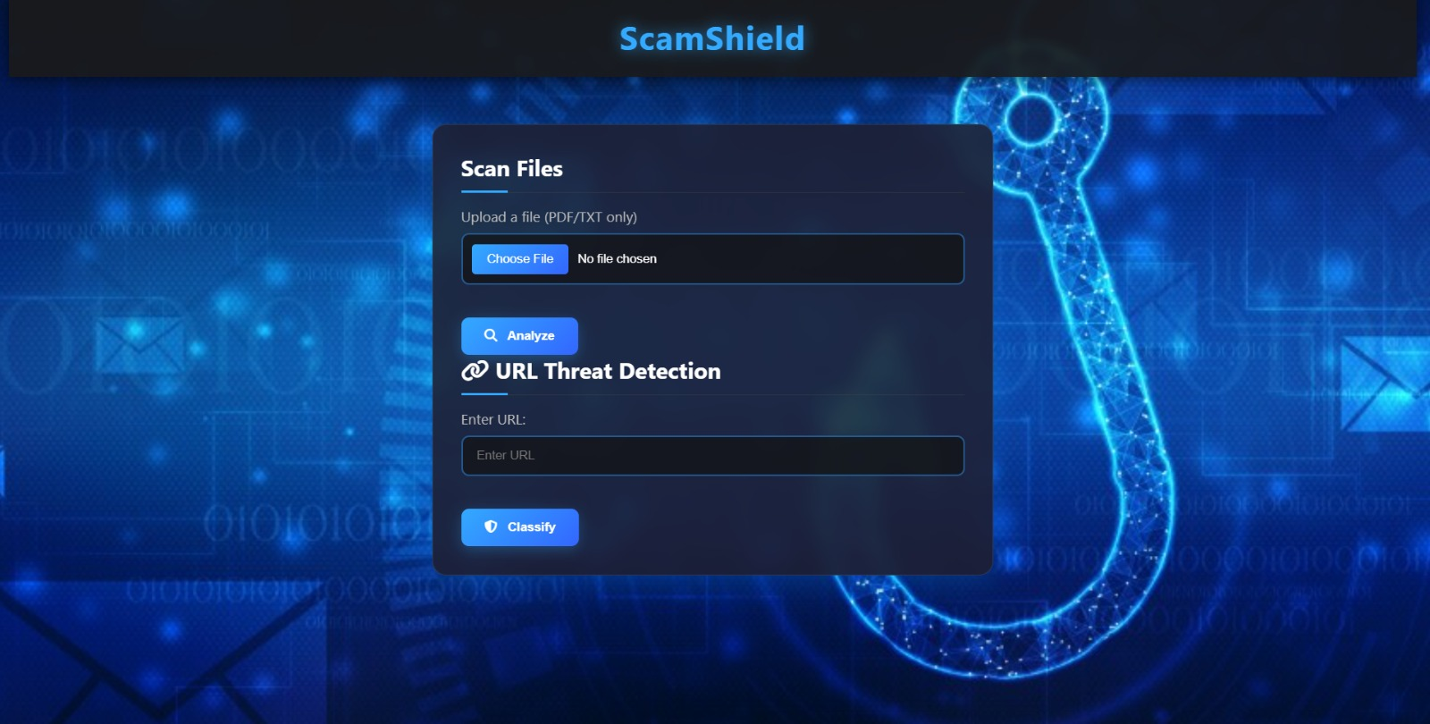
OUTPUT

Slide 9
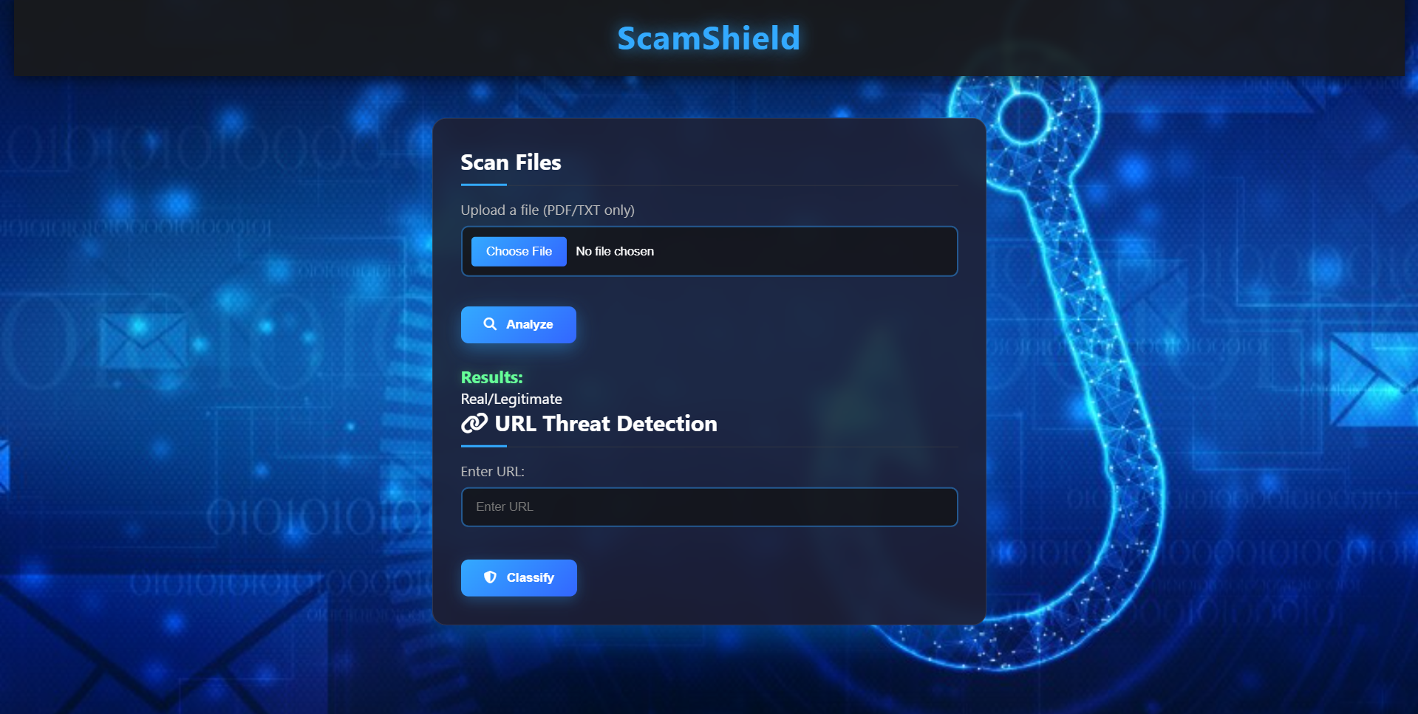
OUTPUT

Slide 10
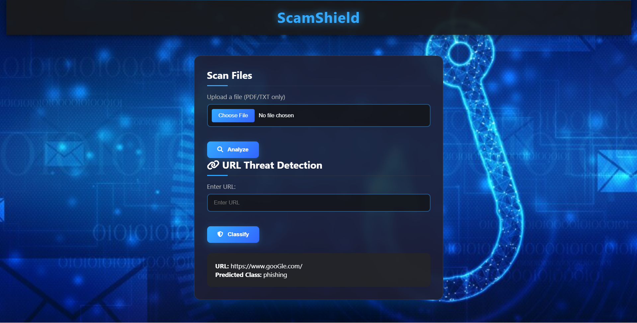
OUTPUT

Slide 11
Future Enhancements
Expand File Support: Include DOCX, images, etc.
Database Integration: Log detected threats for analysis.
User Accounts: Save scan history.
Browser Extension: Real-time URL checking.

Slide 12
Conclusion
ScamShield is a practical tool for detecting scams and malicious URLs.
Combines AI power with a user-friendly interface.
Helps users stay safe in the digital world.

